Slide 1
Plotting coordinates generated from a rule
Plotting coordinates

Slide 2
how to use Oak lessons

Slide 3
I can represent a set of coordinates, constructed according to a mathematical rule, both algebraically and graphically.

Slide 4
An equation is used to show two expressions that are equal to each other.

Slide 5

Plotting coordinates generated from a rule
Finding a rule from a set of coordinates
Generating coordinates from a rule
Plotting coordinates that follow a rule

Slide 6

Finding a rule from a set of coordinates
We can describe coordinates that follow a pattern by looking at the relationship between the x and y coordinates.
Look at the coordinates below:
+2
+2
+2
+2
(0,2) (1,3) (2,4) (3,5)
What do you notice?
Can you describe the relationship between the x and y coordinate?
The coordinate plus 2 gives the coordinate.
The coordinate is the coordinate plus 2.

Slide 7
Finding a rule from a set of coordinates
Look at the coordinates below:
+3
+3
+3
(0,3) (1,4) (2,5)
Can you describe the relationship between the x and y coordinate?
The coordinate is the coordinate plus 3.
Does the coordinate (6,3) follow the same rule?
+3
No
Does the coordinate (3,6) follow this rule?
+3
Yes

Slide 8

Finding a rule from a set of coordinates
We can describe relationships using equations.
-10
-10
-10
(10,0) (13.5,3.5) (6,-4)
The y coordinate is equal to the x coordinate minus 10.
How could we form an equation to show this relationship?

Slide 9
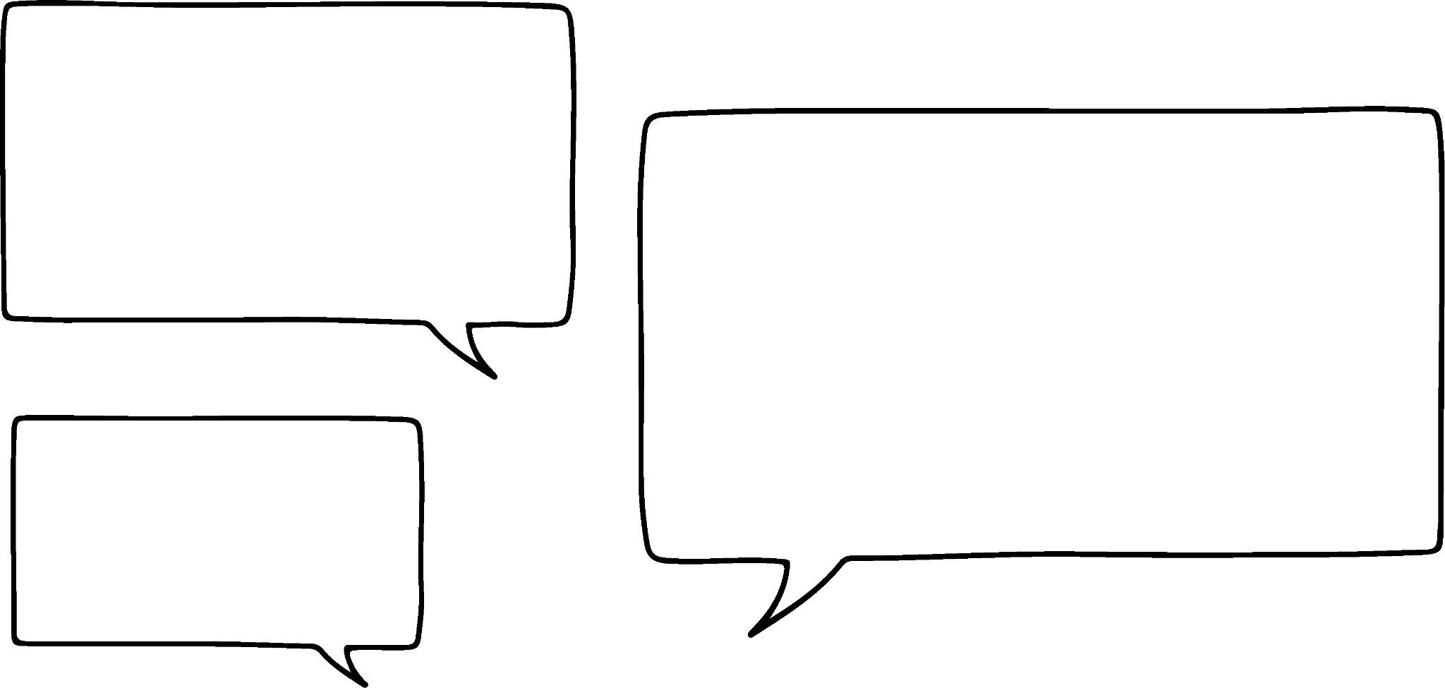


Finding a rule from a set of coordinates
Jacob and Sofia are writing an equation for this set of coordinates
(10,5) (7,3.5) (4,2)
Who is correct?
The y coordinate is double the x coordinate
The y coordinate is half the x coordinate
Jacob:
Sofia:

Slide 10

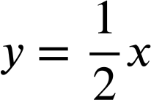
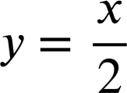
Finding a rule from a set of coordinates
(10,5) (7,3.5) (4,2)
The y coordinate is double the x coordinate
The y coordinate is half the x coordinate
Sofia is correct (10, 5) (7,3.5) (4,2)
How could we write an equation for this relationship?
Halving a number is the same as multiplying by or dividing by 2
or

Slide 11

Finding a rule from a set of coordinates
Jacob and Sofia are writing a rule for the coordinates
(-3,-5) (0,-2) (4,2)
How do you know Jacob is incorrect?
The rule is
This only works for the last coordinate.
-3 ÷ 2 is not -5.
0 ÷ 2 is not -2
Jacob:
How do you know Sofia is incorrect?
The rule is
0 + 2 does not equal -2
-3 + 2 does not equal -5
4 + 2 does not equal 2
Sofia:

Slide 12


Finding a rule from a set of coordinates
For each set of coordinates, fill in the gaps to describe the relationship in words and using algebra:
(0,1) (2,3) (9,10)
The y coordinate is equal to the x coordinate .
(2,6) (-4,0) (4,8)
The y coordinate is equal to the x coordinate plus 4.
(10,5) (4,-1) (0,-5)
The y coordinate is equal to the x coordinate .
(-7,-2) (-3,2) (2.2,7.2)
The y coordinate is .

Slide 13
Finding a rule from a set of coordinates
For each set of coordinates, fill in the gaps to describe the relationship in words and using algebra:
(2,4) (3,6) (8,16)
The y coordinate is .
(2,20) (-4,-40) (3,30)
The y coordinate is .
(0,0) (1,5) (-1,-5)
The y coordinate is .
(10,1) (6,0.6) (30,3)
The y coordinate is .

Slide 14



Finding a rule from a set of coordinates
For each set of coordinates, fill in the gaps to describe the relationship in words and using algebra:
(0,1) (2,3) (9,10)
The y coordinate is equal to the x coordinate plus 1.
(2,6) (-4,0) (4,8)
The y coordinate is equal to the x coordinate plus 4.
(10,5) (4,-1) (0,-5)
The y coordinate is equal to the x coordinate minus 5.
(-7,-2) (-3,2) (2.2,7.2)
The y coordinate is equal to the x coordinate plus 5..

Slide 15



Finding a rule from a set of coordinates
For each set of coordinates, fill in the gaps to describe the relationship in words and using algebra:
(2,4) (3,6) (8,16)
The y coordinate is double the x coordinate..
(2,20) (-4,-40) (3,30)
The y coordinate is ten times the x coordinate.
(0,0) (1,5) (-1,-5)
The y coordinate is the x coordinate multiplied by 5..
.

Slide 16
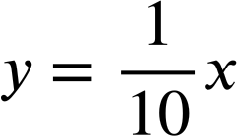
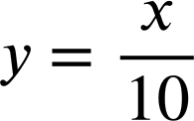
Finding a rule from a set of coordinates
For each set of coordinates, fill in the gaps to describe the relationship in words and using algebra:
(10,1) (6,0.6) (30,3)
The y coordinate is the x coordinate divided by 10.
or

Slide 17
Plotting coordinates generated from a rule
Finding a rule from a set of coordinates
Generating coordinates from a rule
Plotting coordinates that follow a rule

Slide 18
Generating coordinates from a rule
Alex wants to write a coordinate where the y value is the x value multiplied by 5.
×5
What coordinates can he write? How many can you think of?
( , )
E.g (0,0)
(1,5)
(2,10)
(10,50)
(0.5,2.5)
( , )
(-0.1,-0.5)
(0.6,3)
(-1,-5)
(100,500)
(-3,-15)
(-20,-100)

Slide 19
Generating coordinates from a rule
Alex wants to write a new coordinate where the y value is the x value plus 30.
What coordinates could he have?
E.g (0,30) (10,40) (100,130) (-50,-20)
He also wants his coordinate to follow the rule. ‘The y value is double the x value. Is there a coordinate that will fit both rules?
(30, 60)

Slide 20
Generating coordinates from a rule
Sam wants to write some coordinates where:
‘the y value is the x value minus 7’
They have chosen some x coordinates to use, how could they work out the
y coordinates?
-7
-7
-7
-7
3
(7.5,
0.5
-4
–7
(10, )
)
(3,
)
(0,
)
They have chosen some y coordinates to use, how could they work out the
x coordinates?
+7
-7
+7
+7
+7
10
7
5
9.1
( ,3)
( ,0 )
( ,-2)
( ,2.1)

Slide 21

Generating coordinates from a rule
We can generate coordinates that satisfy an equation.
Write a coordinate that satisfies the equation:
E.g (0,5) (1,6) (5,10) (10,15) (-5,0)...

Slide 22

Generating coordinates from a rule
We can generate coordinates that satisfy an equation.
Write a coordinate that satisfies the equation:
E.g (0,0) (1,7) (2,14) (100,700) (-5,-35)...

Slide 23


Generating coordinates from a rule
We can generate coordinates that satisfy an equation:
Which
of
these
coordinates
would
satisfy
the equation
?
(10,12.1)
(103,105)
(-2.1,0)
(5,2.9)
(3,2.1)
(2.1,0)
How do you know?
The x coordinate plus 2.1 gives the y coordinate.
Which
of
these
coordinates
would
satisfy
the equation
?
(10,-5)
(3,6)
(1,-2)
(5,3)
(-4,8)
(-6,-12)
How do you know?
The x coordinate multiplied by -2 gives the y coordinate.

Slide 24

Generating coordinates from a rule
What is the missing value in each coordinate pair for the equation:
(12, )
15
97
( ,100)
(-0.5,
2.5
)

Slide 25




Generating coordinates from a rule
Generate 3 coordinates that follow each rule. Some have the x or y coordinate already filled in.
( 3 , ) ( , ) ( , )
( 0 , ) ( , 9 ) ( , )
( 0 , ) ( ,300) ( , )
( 0 , ) ( , ) ( , )

Slide 26






Generating coordinates from a rule
Fill in the table with a different coordinate for the equation that satisfies each condition. The first one has been done for you.
 | The y coordinate is positive | The y coordinate is negative | The y coordinate is a non-integer
 | (15,10) | (-5,-10) | (7.5, 2.5)
a)
b)
c)
d)
e)
f)

Slide 27
Generating coordinates from a rule
Generate 3 coordinates that follow each rule. Some have the x or y coordinate already filled in.
There are many possible answers for the blank coordinates. Examples:
23
( , )
( , )
)
( 3 ,
( 0 ,
( 0 ,
( 0 ,
(0,20) (1,21) (10,30) (-20,0)
-9
18
)
( , 9 )
( , )
(1,-8) (10,1) (-2,-11) (100,91)
0
3
)
( , 300 )
( , )
(1,100) (0.1,10) (10,1000) (-3,-300)
0
( , )
( , )
)
(1,4) (2,8) (25,100) (-3,-12)

Slide 28
Generating coordinates from a rule
Fill in the table with a different coordinate for the equation that satisfies each condition. The first one has been done for you.
 | The y coordinate is positive | The y coordinate is negative | The x coordinate is a non-integer
 | (15,10) | (-5,-10) | (7.5, 2.5)
a)
b)
c)
d)
e)
f)
E.g (-4, 6)
E.g (-20, -10)
E.g (0.2, 10.2)
E.g (2, 10)
E.g (-10, -50)
E.g (0.1, 0.5)
E.g (-3, 9)
E.g (2, -6)
E.g (0.5, -1.5)
E.g (6,5.98)
E.g (-5, -5.02)
E.g (0.52, 0.5)
E.g (9, 3)
E.g (-12, -4)
E.g (3.9, 1.3)

Slide 29
Plotting coordinates generated from a rule
Finding a rule from a set of coordinates
Generating coordinates from a rule
Plotting coordinates that follow a rule

Slide 30

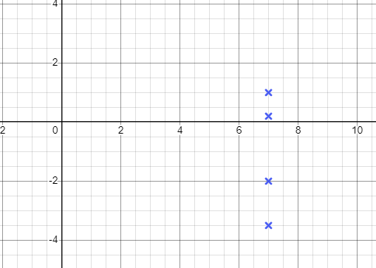
Plotting coordinates that follow a rule
Laura is plotting the coordinates
(7,1) (7,-2) (7,0.2) (7,-3.5)
What do you notice about these coordinates?
The x coordinate is always 7
How could we write an equation for this rule?
What would these coordinates look like if we plotted them?

Slide 31
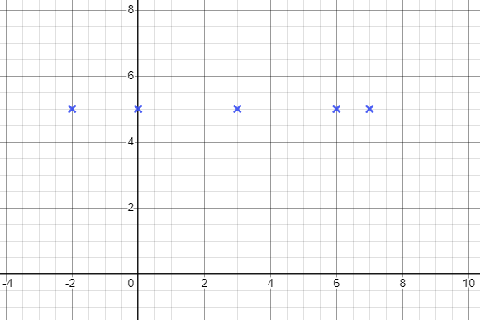

Plotting coordinates that follow a rule
Coordinates that follow a rule will form a pattern when plotted.
What will the coordinates below look like when plotted?
(-2,5) (0,5) (3,5) (6,5) (7.002, 5)
How could we write an equation for the rule this time?
The y coordinate is always 5

Slide 32
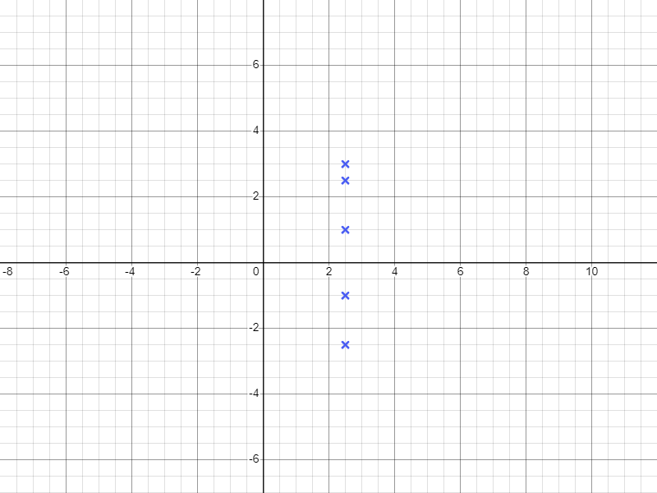
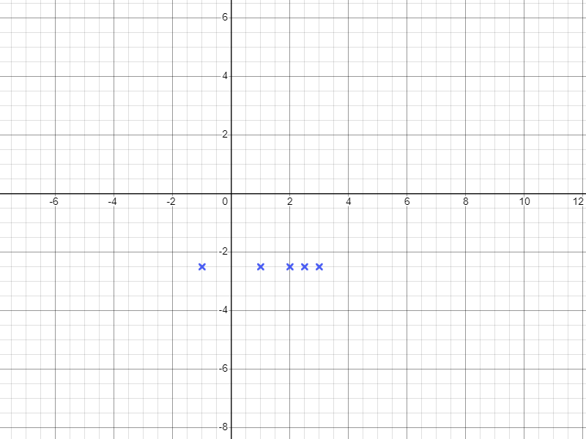
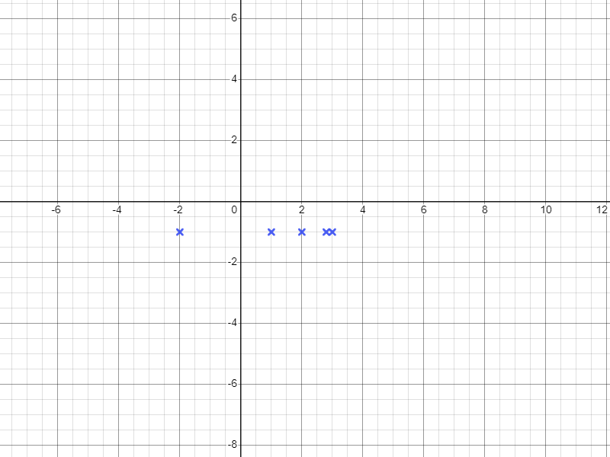
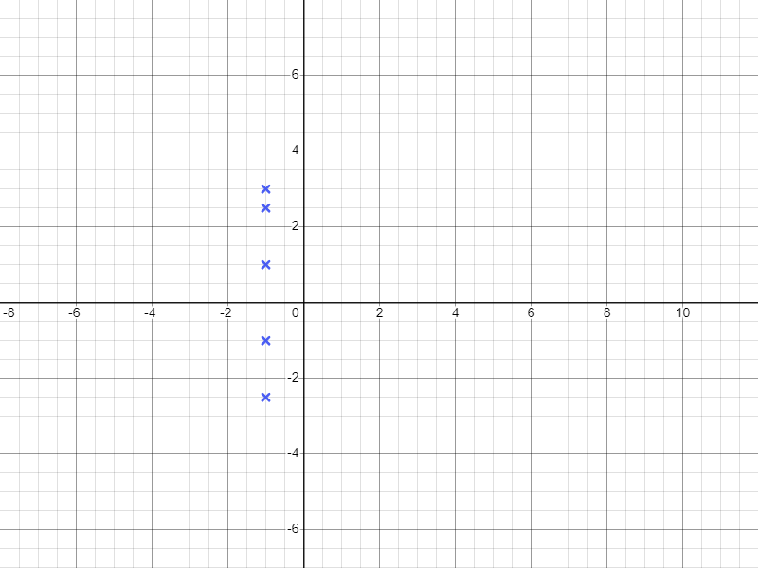
Plotting coordinates that follow a rule
Match the rule and the coordinates with the correct graph.

Slide 33

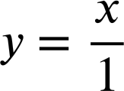


Plotting coordinates that follow a rule
Laura has found some coordinates that seem to follow a pattern: (1,1) (2,2) (3,3) (4,4)
I think the rule is:
The rule can be written as:
Jacob:
I would write the rule as:
Sofia:
Jun:
Who is correct?

Slide 34

Plotting coordinates that follow a rule
Laura has found some coordinates that seem to follow a pattern:
(1,1) (2,2) (3,3) (4,4)
The rule can be written as:
I think the rule is:
Jacob:
Sofia:
All 3 answers are correct.
However all 3 can be written more simply as:
I would write the rule as:
Jun:

Slide 35
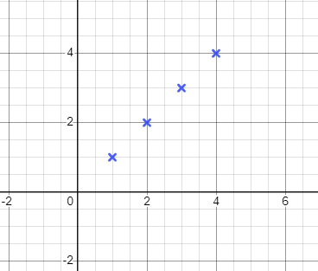
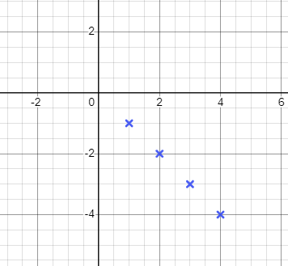

Plotting coordinates that follow a rule
What will these coordinates look like when plotted?
(1,1) (2,2) (3,3) (4,4)
Laura then plots
(1,-1) (2,-2) (3,-3) (4,-4)
Will this look the same?
No, the coordinates follow a different rule.
How can we write the rule for these coordinates?

Slide 36


Plotting coordinates that follow a rule
These coordinates will make a straight line when plotted
(1,3) (0,0) (0.5,1.5) (-2,-6)
You can draw a straight line between any four points.
These coordinates all follow a rule.
The rule is:

Slide 37
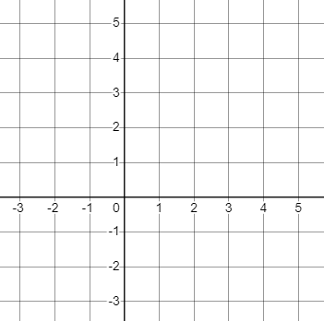
Plotting coordinates that follow a rule
Plot all the integer points that satisfy each rule.
a) The x value is 1
b) The y value is one less than the x value
The y value is double the x value
Describe the pattern.
Describe the pattern.
Describe the pattern.

Slide 38



Plotting coordinates that follow a rule
Plot all the integer points that satisfy each rule.
d)
e)
f)
Describe the pattern.
Describe the pattern.
Describe the pattern.

Slide 39
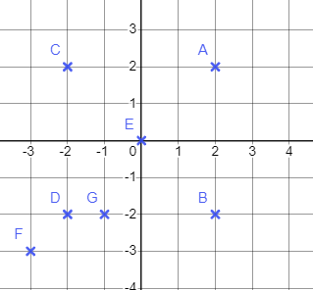



Plotting coordinates that follow a rule
2) The grid shows seven points labelled A, B, C, D, E, F and G. Complete the table to show which points have coordinates that match the rules below. The first column has been completed for you.
Rule | A | B | C | D | E | F | G
 | yes
 | no
 | yes
 | no

Slide 40
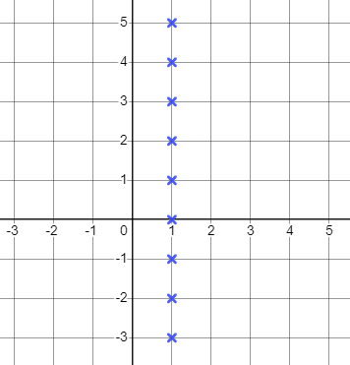
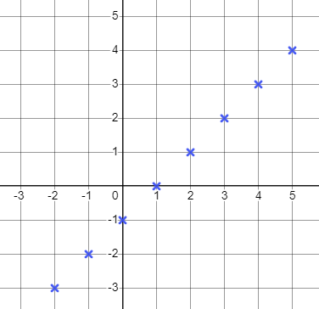
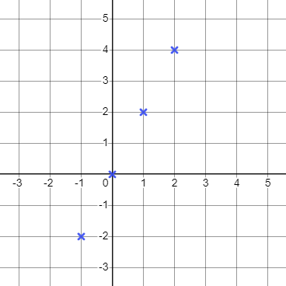
Plotting coordinates that follow a rule
Plot all the integer points that satisfy each rule.
a) The x value is 1
b) The y value is one less than the x value
c) The y value is double the x value
Describe the pattern.
Describe the pattern.
Describe the pattern.
A vertical line
A diagonal line
A diagonal line

Slide 41
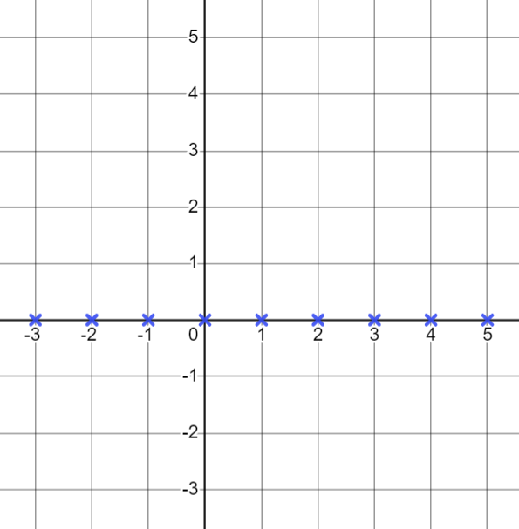
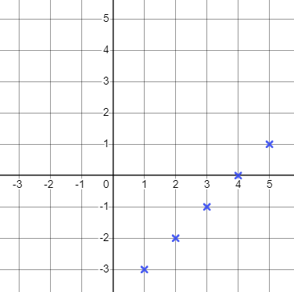
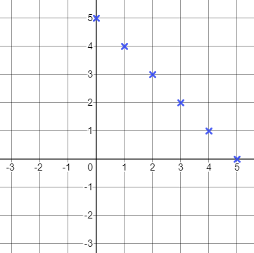
Plotting coordinates that follow a rule
Plot all the integer points that satisfy each rule.
d)
e)
f)
Describe the pattern.
Describe the pattern.
Describe the pattern.
A horizontal line, the x axis
A diagonal line
A diagonal line

Slide 42
Plotting coordinates that follow a rule
2) The grid shows seven points labelled A, B, C, D, E, F and G. Complete the table to show which points have coordinates that match the rules below. The first column has been completed for you.
Rule | A | B | C | D | E | F | G
 | yes | yes | no | no | no | no | no
 | no | yes | no | yes | no | no | yes
 | yes | no | no | yes | yes | yes | no
 | no | yes | yes | no | yes | no | no

Slide 43
Plotting coordinates generated from a rule.
Coordinates that follow a pattern can be described with a worded rule or as an equation.
We can generate coordinates that follow a worded rule or satisfy an equation.
Coordinates that follow a rule will form a pattern when plotted.

Slide 44

© Oak National Academy 2023.
Produced in partnership with Mathematics in Education and Industry.
Licensed on the Open Government Licence v3.0, except where otherwise stated. See Oak terms and conditions.

